Slide 1
EE 295
Tech Writing-Engineering Ethics
Sep 17, 2019
Room E339
Tom Wrappe
EE Lecturer

Slide 2
Agenda
Writing Techniques
Passive Voice
Gadget Description
Midterm Paper
Class Topic Feedback
Class Topic Discussions/Groups
Midterm paper sections focus
Colonization (Ch 3 Moriarity)
Next class
-Chapter 4: Ethics of the Person (Read and prepare)

Slide 3
Focus on Writing Items
--Paragraph Construction
+Paragraphs are a basic building block of good tech writing
+Well constructed paragraphs are solid and modular while poorly constructed paragraphs cause architectural flaws
--Passive Voice
+Active voice approach is simpler and more concise than passive voice
+Avoid significant use of passive voice

Slide 4
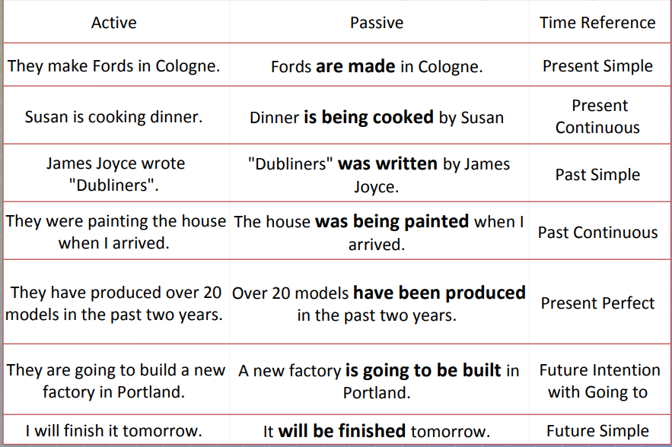
Active and Passive Voice Summary

Slide 5
Tech Descriptive Writing
-Product Description -Structure and Examples (note: you will not be doing figures, so need to rely on written descriptions)
https://www.tu-chemnitz.de/phil/english/sections/linguist/independent/kursmaterialien/TechComm/acchtml/desc.html

Slide 6
Tech Description (General)
Introduction (The tech of interest is…..)
-Indicate the specific object about to be described.
-Indicate what the audience needs in terms of knowledge and background to understand the description.
-Give a general description of the object and its function, cause, or effect.
-Give an overview of the contents of the description.
Background
Discussion of the parts or characteristics
Discussion of the related operation or process

Slide 7
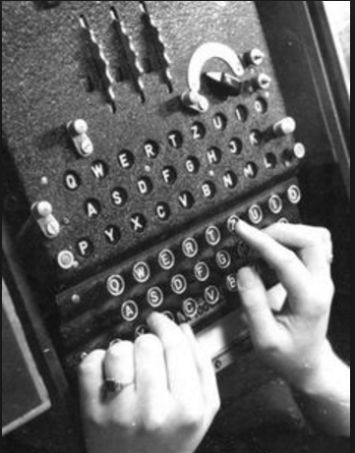
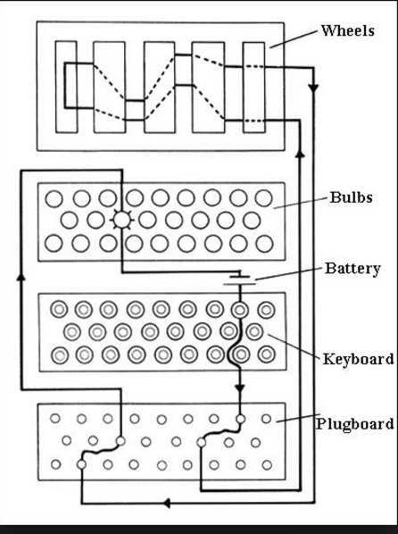
Gadget Description: Crypto Coder Machine (Enigma)
Enter letter in 4, get coded equivalent at 2.
3
1
1
2
2
3
4
4
5
5

Slide 8
Enigma Discussion Items
Report Type?
-Product/Device Description
Key conclusions of report
-Overview: Main function(s) of the device?
-Physical description
System Overview
Physical Modules
How the Device accomplishes the function(s)
-Logical Elements
-Process

Slide 9
Tech Description: Enigma
General Tech Description | Enigma Related Items
Intro -Specific object -Quick background -General description of function, cause, effect -Overview of the contents | -Enigma is a system that allows secure messaging by scrambling the letters of the actual message -Enigma is a box that looks like a typewriter that codes and decodes letters of messages -Enigma uses a cypher technique -Key elements are inputs (keyboard), processor (cylinders with multiple settings) and outputs (lamps on letters)
Background | Developed by Germans for secure battle communications
Discussion of parts/characteristics | Physical appearance Main subsystems
Discuss Related operation | How message gets coded and decoded using the subsystems

Slide 10
Tech Descriptive Writing: Blockchain Description

Slide 11
Out of Class Writing Assignment #2
Due, Thu, Sep 19 @11:59pm
FOLLOW ALL INSTRUCTIONS
-Write an informational report to describe "What is Blockchain?" and submit via Canvas
1. 500-600 words (approx 2 pages #12 font double spaced). NO PICTURES, JUST TEXT DESCRIPTION. The goal is that the audience (class members) can understand and describe what Blockchain is and what the technology can do based on your description.
2. Provide a title followed by 3 or 4 paragraphs using the following high level outline:
a. Summary
b. Body
c. Conclusion
3. As a condition of grading, supply the following (on a “Self Grading Report” page following the assignment)
a. Word count
b. Underline or highlight the topic sentence of each paragraph in the paper
c. Provide your check of the EE295 key elements by filling out and including certification of 1. No personal pronouns, 2. No use of passive voice, 3. no use of "very", 4. All paragraphs complete and at least 3 sentences. Provide a table with these four rows and a column noting your compliance to each element.

Slide 12
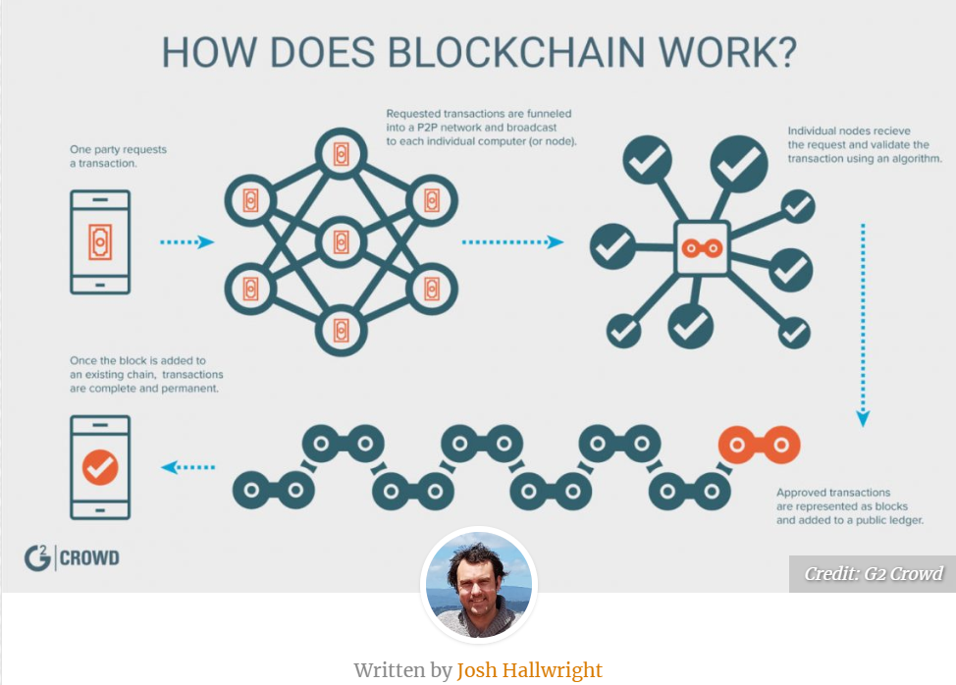

Slide 13
Blockchain Discussion Items
Report Type? Product/Technology Description
Key conclusions of report:
What is Blockchain (BC) and why is it important?
How does BC work?
What can BC do?

Slide 14
Tech Description: Blockchain
General Tech Description | Blockchain Related Items
Intro -Specific object -Quick background -General description of function, cause, effect -Overview of the contents | Blockchain is a secure ledger technology that provides foundation for multiple advanced services
Background
Discussion of parts/characteristics
Discuss Related operation
Conclusion | Blockchain is a technology that underlies safe and useful products

Slide 15
Midterm Topic Discussions

Slide 16
Semester Major Items…..(subject to modification)
 | Mid Term | Resume | Final Paper | Final Presentation (slides )
Topic Paragraph | 9.5.19
Topic Proposed | 9.12.19 |  | 10.3.19
Topic Final | 9.19.19 |  | 10.10.19
Outline/ Abstract | 9.26.19 |  | 10.31.19
Research | 10.1.19 | 10.24.19 (Class) | 10.15.19
Draft Complete | 10.10.19 |  | 11.7.19 | 11.19.19
Final Submit | 10.22.19 | 11.14.19 | 11.26.19 | 12.3.19
Final Presentation | NA | NA | NA | 12.17.19 (Sect 1) 12.12.19 (Sect 2)

Slide 17
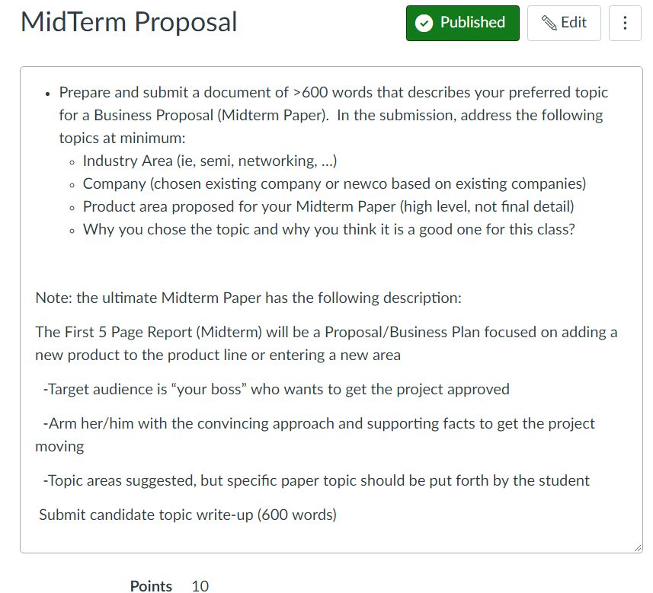

Slide 18
Topic Areas
Networks, AI, wireless, IC technology, drones, driverless cars, robotics, are all moving at high speed
Examples:
-A wireless Chipset company that has large market share in 4G proposes a 5G Project (Nvidia, Intel, Qualcomm, Nvidia)
-An established Networking company proposes adding extensions to its product line
-A GPS company that sells navigation units considers expanding to address autonomous cars
-Network company considers adding big data services by adding analytics to their process
A startup team out of Google wants to build driverless cars

Slide 19
Feedback Items from Midterm Topic Exercise
Read comments notes from grader: Some topics need to be adjusted to go to next level. Need concise topic –discussing in class today
Descriptive title. Not “Homework” or “Midterm Topic”. Use “Automated Parking Garage” or “Smart Camera Network Product”
(Always capitalize large words in the Title)
2. Structure/Flow
Summary (The proposed product is….Class group discussion with group members working together to refine fully) plus necessary background to support the chosen product.
Product description (physical, functional, operational)
Product differentiation (key advanced features)
Conclusion (why this is a safe and useful product?)
3. Combine short sentences. Ex: “The term “robotic” usually misdirects people. Robots do not perform the operation. The doctor performance surgery with a robot by utilizing the tools that he or she conducts through a console.”
4. Catch phrases that say nothing: “Growing day by day”, “The most important development of the modern era is..”

Slide 20
In Class Topic Peer Discussion
Break into Groups of 2. If odd number, one group of 3.
Discuss your topic with your partner(s)
The proposed product is…….
This is a “safe and useful product because”….
3. Is the topic well articulated? Peer-Peer based on Criteria?
4. The partner (not the author) should report to the group about the product, so rehearse and get ready to report
Depends on the author/proposer being clear about their proposal and the “audience” providing feedback on their understanding
Concise and clear really matter

Slide 21
Topic Well Articulated?
Is the product/ project clearly defined? (0-20)
The proposed product is…..
Scope
Customers
Value proposition
Does the paper support the customer (the “Boss”) in his objective to sell? (0-20)
Differentiated, unique features
Attractive market
Leverages the “company” assets and expertise
Is the flow from idea to the chosen level of implementation orderly and clear? (0-20)
Clear Conclusion: This is a safe and useful product because….. (0-20)

Slide 22
Ch 3: Impact of Technology (Moriarty)
-How does a technology Invade or Colonize the world?
+Productivity
+Efficiency
-Technology has intended and unintended consequences
+Primary impact by design
+Other consequences by impact of “colonization” once tech has “settled” into the world
-Modern engineering is mainly a colonizing process
+The main purpose of the technology is accomplished
+Repercussions to the rest of the lifeworld are largely unchecked

Slide 23
Video: Google Privacy Policy

Slide 24
Discussion Questions
Is it ethical that Google offers services “for free” that are not really free?
How have internet services “colonized” the world?
What was the primary service purpose for Google “free” services? What have been the unintended consequences of these services?
If you were a Google engineer developing search engines and algorithms, what is your ethical duty related to your work?
What other examples of unintended consequences do you see in everyday life? What can you do about them?

